Slide 1
The Consumer Theory
How Consumers Make Choices under Income Constraints

Slide 2
Some Questions
What is behind a consumer’s demand curve?
How do consumers choose from among various consumer “goods”?
What determines the value of a consumer good?

Slide 3
Utility
The value a consumer places on a unit of a good or service depends on the pleasure or satisfaction he or she expects to derive from having or consuming it at the point of making a consumption (consumer) choice.
In economics the satisfaction or pleasure consumers derive from the consumption of consumer goods is called “utility”.
Consumers, however, cannot have every thing they wish to have. Consumers’ choices are constrained by their incomes.
Within the limits of their incomes, consumers make their consumption choices by evaluating and comparing consumer goods with regard to their “utilities.”

Slide 4
Cardinal and Ordinal Utility
The utility is a psychological phenomenon; that implies the satisfying power of a good or service.
It differs from person to person, as it depends on a person’s mental attitude. The measurability of utility is always a matter of contention.
The two principal theories for the utility are cardinal utility and ordinal utility. Many traditional economists hold the view that utility is measured quantitatively, like length, height, weight, temperature, etc. This concept is known as cardinal utility concept.
On the other hand, ordinal utility concept expresses the utility of a commodity in terms of ‘less than’ or ‘more than’.

Slide 5
Comparison: Cardinal and Ordinal Utility
Meaning | Cardinal utility is the utility wherein the satisfaction derived by the consumers from the consumption of good or service can be expressed numerically. | Ordinal utility states that the satisfaction which a consumer derives from the consumption of good or service cannot be expressed numerical units.
Approach | Quantitative | Qualitative
Realistic | Less | More
Measurement | Utils | Rank
Analysis | Marginal Utility Analysis | Indifference curves
Promoted by | Classical and Neo-classical Economists | Modern Economists

Slide 6
Our basic assumptions about a “rational” consumer:
Consumers are utility maximizers
Consumers prefer more of a good (thing) to less of it.
Facing choices X and Y, a consumer would either prefer X to Y or Y to X, or would be indifferent between them.
Transitivity: If a consumer prefers X to Y and Y to Z, we conclude he/she prefers X to Z
Diminishing marginal utility: As more and more of good is consumed by a consumer, ceteris paribus, beyond a certain point the utility of each additional unit starts to fall.

Slide 7
Total Utility versus Marginal Utility
Marginal utility is the utility a consumer derives from the last unit of a consumer good she or he consumes (during a given consumption period), ceteris paribus.
Total utility is the total utility a consumer derives from the consumption of all of the units of a good or a combination of goods over a given consumption period, ceteris paribus.
Total utility = Sum of marginal utilities

Slide 8
The Law of Diminishing Marginal Utility
Over a given consumption period, the more of a good a consumer has, or has consumed, the less marginal utility an additional unit contributes to his or her overall satisfaction (total utility).
Alternatively, we could say: over a given consumption period, as more and more of a good is consumed by a consumer, beyond a certain point, the marginal utility of additional units begins to fall.

Slide 9
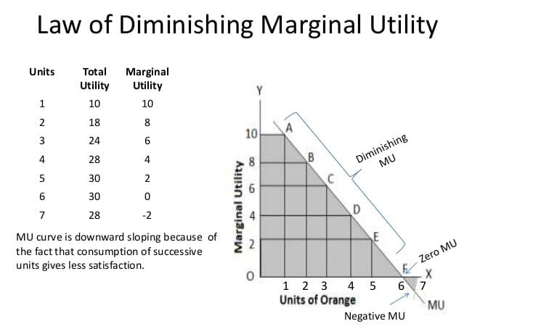

Slide 10
Theory of Consumer Choice

Slide 11
Introduction
People face tradeoffs
Buying more of one good leaves less income to buy other goods.
Working more hours means more income and more consumption, but less leisure time.
Reducing saving allows more consumption today but reduces future consumption.
Notes:
11

Slide 12
The Budget Constraint: What the Consumer Can Afford
Example: Hurley divides his income between two goods: fish and mangos.
A “consumption bundle” is a particular combination of the goods, e.g., 40 fish & 300 mangos.
Budget constraint: the limit on the consumption bundles that a consumer can afford given his income.
Notes:
12
The two-good assumption greatly simplifies the analysis without altering the basic insights about consumer choice.
If your students remember the Production Possibilities Frontier, you might tell them that a budget constraint is, in essence, a “consumption possibilities frontier” for the consumer: it shows all combinations (bundles) of the two goods that the consumer can afford to buy.

Slide 13
A C T I V E L E A R N I N G 1 Budget Constraint
Hurley’s income: $1200
Prices: P_{F} = $4 per fish, P_{M} = $1 per mango
A. If Hurley spends all his income on fish, how many fish does he buy?
B. If Hurley spends all his income on mangos, how many mangos does he buy?
C. If Hurley buys 100 fish, how many mangos can he buy?
D. Plot each of the bundles from parts A – C on a graph that measures fish on the horizontal axis and mangos on the vertical, connect the dots.
13
Notes:
A very straightforward exercise.

Slide 14
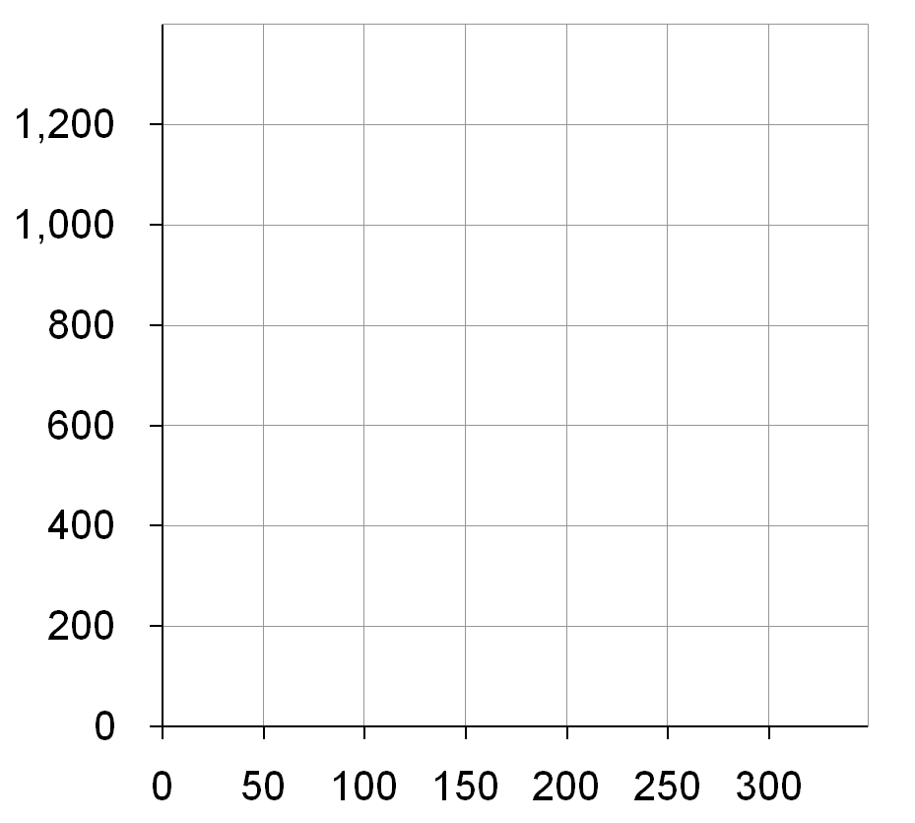
A C T I V E L E A R N I N G 1 Answers
D. Hurley’s budget constraint shows the bundles he can afford.
Quantity of Mangos
B
A. $1200/$4 = 300 fish
B. $1200/$1 = 1200 mangos
C. 100 fish cost $400, $800 left buys 800 mangos
C
A
Quantity of Fish

Slide 15
The Slope of the Budget Constraint
From C to D,
“rise” = –200 mangos
“run” = +50 fish
Slope = – 4
Hurley must give up 4 mangos to get one fish.
Quantity of Mangos
C
D
Quantity of Fish

Slide 16
The Slope of the Budget Constraint
The slope of the budget constraint equals
the rate at which Hurley can trade mangos for fish
the opportunity cost of fish in terms of mangos the relative price of fish:
Notes:
16

Slide 17
A C T I V E L E A R N I N G 2 Budget constraint, continued.
Show what happens to Hurley’s budget constraint if:
A. His income falls to $800.
B. The price of mangos rises to P_{M} = $2 per mango
Notes:
Another straightforward problem that will not take much class time. Yet, students will learn these concepts better by figuring out for themselves how the budget line moves in response to income and price changes.

Slide 18
A C T I V E L E A R N I N G 2 Answers, part A
A fall in income shifts the budget constraint down.
Quantity of Mangos
Now, Hurley can buy
$800/$4 = 200 fish
or $800/$1 = 800 mangos
or any combination in between.
Quantity of Fish

Slide 19
A C T I V E L E A R N I N G 2 Answers, part B
An increase in the price of one good pivots the budget constraint inward.
Hurley can still buy 300 fish.
But now he can only buy $1200/$2 = 600 mangos.
Notice: slope is smaller, relative price of fish is now only 2 mangos.
Quantity of Mangos
Quantity of Fish

Slide 20
Preferences: What the Consumer Wants
Indifference curve: shows consumption bundles of two goods that give the consumer the same level of satisfaction
One of Hurley’s indifference curves
Quantity of Mangos
B
A, B, and all other bundles on I₁ make Hurley equally happy – he is indifferent between them.
A
I₁
Quantity of Fish

Slide 21
Four Properties of Indifference Curves
One of Hurley’s indifference curves
1. Indifference curves are downward-sloping.
Quantity of Mangos
If the quantity of fish is reduced,
the quantity of mangos must be increased to keep Hurley equally happy.
B
A
I₁
Quantity of Fish

Slide 22
Four Properties of Indifference Curves
A few of Hurley’s indifference curves
2. Higher indifference curves are preferred to lower ones.
Quantity of Mangos
Hurley prefers every bundle on I₂ (like C) to every bundle on I₁ (like A).
C
D
A
I₂
He prefers every bundle on I₁ (like A) to every bundle on I₀ (like D).
I₁
I₀
Quantity of Fish

Slide 23
Four Properties of Indifference Curves
Hurley’s indifference curves
3. Indifference curves cannot cross.
Quantity of Mangos
Suppose they did.
Hurley should prefer B to C, since B has more of both goods.
Yet, Hurley is indifferent between B and C:
He likes C as much as A (both are on I₄).
He likes A as much as B (both are on I₁).
B
C
A
I₁
I₄
Quantity of Fish

Slide 24
Four Properties of Indifference Curves
4. Indifference curves are bowed inward.
Quantity of Mangos
Hurley is willing to give up more mangos for a fish if he has few fish (A) than if he has many (B).
A
6
1
B
2
1
I₁
Quantity of Fish
Notes:
Hurley has more fish at B than at A, so an extra fish would be less valuable at B than at A.

Slide 25
The Marginal Rate of Substitution
MRS = slope of indifference curve
Marginal rate of substitution (MRS): the rate at which a consumer is willing to trade one good for another.
Quantity of Mangos
A
MRS =
6
Hurley’s MRS is the amount of mangos he would substitute for another fish.
1
B
MRS =
2
1
I₁
MRS falls as you move down along an indifference curve.
Quantity of Fish
Notes:
At A, Hurley has few fish, so an additional fish is very valuable to him.
At B, Hurley already has lots of fish, so an additional one is not as valuable to him.

Slide 26
Optimization: What the Consumer Chooses
A is the optimum: the point on the budget constraint that touches the highest possible indifference curve.
Quantity of Mangos
The optimum is the bundle Hurley most prefers out of all the bundles he can afford.
1200
Hurley prefers B to A, but he cannot afford B.
B
A
600
Hurley can afford C and D, but A is on a higher indifference curve.
C
D
150
300
Quantity of Fish
Notes:
Simply put, optimization means buying the bundle that makes the consumer happiest, given his or her income.

Slide 27
Optimization: What the Consumer Chooses
Quantity of Mangos
Consumer optimization is another example of “thinking at the margin.”
At the optimum,
slope of the indifference curve equals slope of the budget constraint:
1200
MRS = P_{F}/P_{M}
A
600
marginal value of fish (in terms of mangos)
price of fish (in terms of mangos)
150
300
Quantity of Fish
Notes:
Consumer optimization is another example of “thinking at the margin.”
Remember that MRS = marginal value of the good on the X-axis (fish) in terms of the good on Y-axis (mangos).
If MRS > Pf/Pm, the value of another fish is greater than its cost, so Hurley can make himself happier by decreasing his mango purchases and using the proceeds to buy another fish.
If MRS < Pf/Pm, the value of another fish is less than its cost, so Hurley should move along his budget line to a bundle with less fish and more mangos to make himself happier.

Slide 28
The Effects of an Increase in Income
Quantity of Mangos
An increase in income shifts the budget constraint outward.
If both goods are “normal,” Hurley buys more of each.
B
A
Quantity of Fish
Notes:
In Active Learning 2, students determined that a fall in income shifts the budget constraint downward. They should readily accept, then, that an increase in income shifts the budget line upward/outward.

Slide 29
The Income and Substitution Effects
A fall in the price of fish has two effects on Hurley’s optimal consumption of both goods.
Income effect A fall in P_{F} boosts the purchasing power of Hurley’s income, allows him to buy more mangos and more fish.
Substitution effect A fall in P_{F} makes mangos more expensive relative to fish, causes Hurley to buy fewer mangos & more fish.
Notice: The net effect on mangos is ambiguous

Slide 30
The Income and Substitution Effects
Initial optimum at A.
P_{F} falls.
Substitution effect: from A to B, buy more fish and fewer mangos.
Income effect: from B to C, buy more of both goods.
Quantity of Mangos
In this example, the net effect on mangos is negative.
A
C
B
Quantity of Fish
Notes:
This diagram decomposes the movement from the old optimum (A) to the new one (C) into two parts.
The first part, from A to B, represents the substitution effect. It shows the change in the optimal bundle due to the relative price change, holding constant the consumer’s level of well-being.
The second part, from B to C, represents the income effect. It shows the change in the optimal bundle due to the increase in the purchasing power of the consumer’s income. The dashed line through point B is parallel to the new budget line through point C, indicating that we are holding relative prices constant to see how the increase in income affects the optimal bundle.

Slide 31
Summary
A consumer’s budget constraint shows the possible combinations of different goods she can buy given her income and the prices of the goods. The slope of the budget constraint equals the relative price of the goods.
An increase in income shifts the budget constraint outward. A change in the price of one of the goods pivots the budget constraint.
31

Slide 32
Summary
A consumer’s indifference curves represent her preferences. An indifference curve shows all the bundles that give the consumer a certain level of happiness. The consumer prefers points on higher indifference curves to points on lower ones.
The slope of an indifference curve at any point is the marginal rate of substitution – the rate at which the consumer is willing to trade one good for the other.
32

Slide 33
Summary
The consumer optimizes by choosing the point on her budget constraint that lies on the highest indifference curve. At this point, the marginal rate of substitution equals the relative price of the two goods.
When the price of a good falls, the impact on the consumer’s choices can be broken down into two effects, an income effect and a substitution effect.
33

